Slide 1



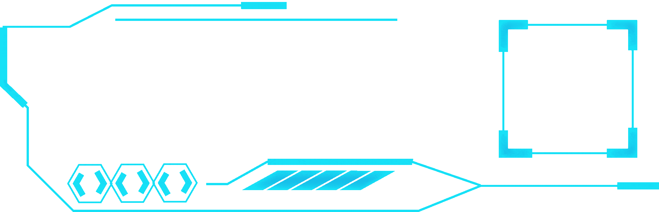


Neural network based
cryptography
Welcome to the future of digital interaction!!!

Slide 2


02
WHAT IS THE Neural Based cryptography?
KEY FEATURES
Work on artificial neural network has been motivated right from its inception by the recognition that the human brain computes in an entirely different way from the conventional digital computer. The brain is a highly complex, nonlinear and parallel information processing system. It has the capability to organize its structural constituents, known as neurons, so as to perform certain computations many times faster than the fastest digital computer in existence today. The brain routinely accomplishes perceptual recognition tasks, e.g. recognizing a familiar face embedded in an unfamiliar scene, in approximately 100-200 ms, whereas tasks of much lesser complexity may take days on a conventional computer.

Slide 3

03
1
Artificial Neural Network
KEY FEATURES
2
Cryptography
3
Biological model
4
ANN (Artificial Neural Network)
5
Cryptographic Algorithms
6
Cryptography using ANN

Slide 4
04
Artificial Neural Network
A neural network is a machine that is designed to model the way in which the brain performs a particular task. The network is implemented by using electronic components or is simulated in software on a digital computer. A neural network is a massively parallel distributed processor made up of simple processing units, which has a natural propensity for storing experimental knowledge and making it available for use. It resembles the brain in two respects:
1. Knowledge is acquired by the network from its environment through a learning process.
2. Interneuron connection strengths, known as synaptic weights, are used to store the acquired knowledge.

Slide 5
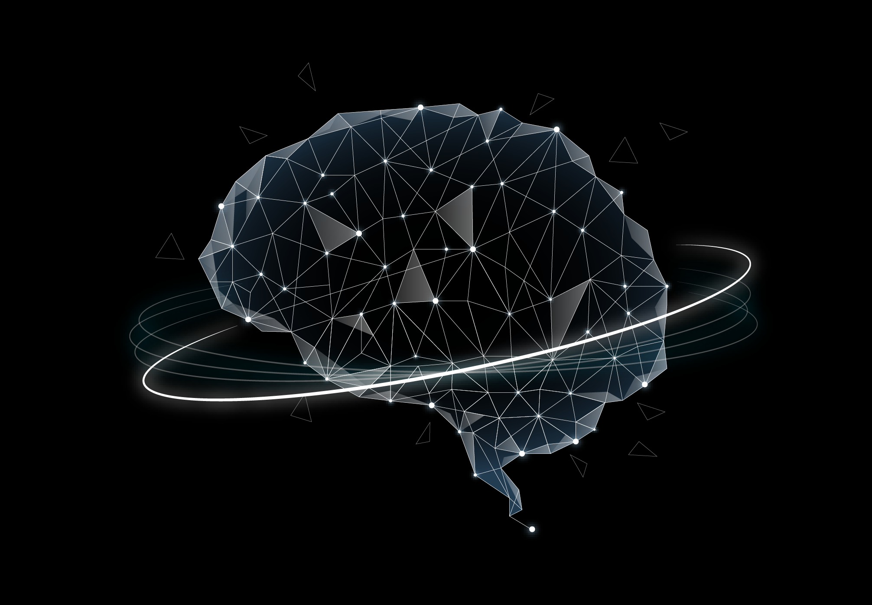


05
Cryptography
There are many aspects to security and many applications, ranging from secure commerce and payments to private communications and protecting passwords. One essential aspect for secure communications is that of cryptography. Cryptography is the science of writing in secret code and is an ancient art.
In data and telecommunications, cryptography is necessary when communicating over any untrusted medium, which includes just about any network, particularly the Internet.
Cryptography, then, not only protects data from theft or alteration, but can also be used for user authentication. There are, in general, three types of cryptographic schemes typically used to accomplish these goals: secret key (or symmetric) cryptography, public-key (or asymmetric) cryptography, and hash functions

Slide 6

06
Biological model
The human nervous system can be broken down into three stages that may be represented as follows:
The receptors collect information from the environment. The effectors generate interactions with the environment e.g. activate muscles. The flow of information/activation is represented by arrows.

Slide 7

07
ANN: Artificial Neural N/W
Artificial Neural Networks (ANN) are densely interconnected frameworks of artificial neurons designed to imitate the brain using software or hardware. They acquire knowledge through learning and store it in weights, also known as coefficients. ANN is particularly well-suited for non-linear applications such as regressions, clustering, and classification. These networks have the remarkable ability to recognize complex patterns and model non-linear systems by learning from examples.
Key advantages of ANN is their high degree of structural parallelism, which allows them to respond quickly. They are frequently used in data modeling and statistical analysis as alternatives to traditional non-linear regression and clustering methods, especially in contexts involving classification or prediction. Deep learning, a subset of ANN, aims to discover relationships between data sets by mimicking brain processes. This approach enables the performance of complex calculations and the detection of patterns and trends in data that are often too intricate for other computer systems or users to identify on their own.

Slide 8
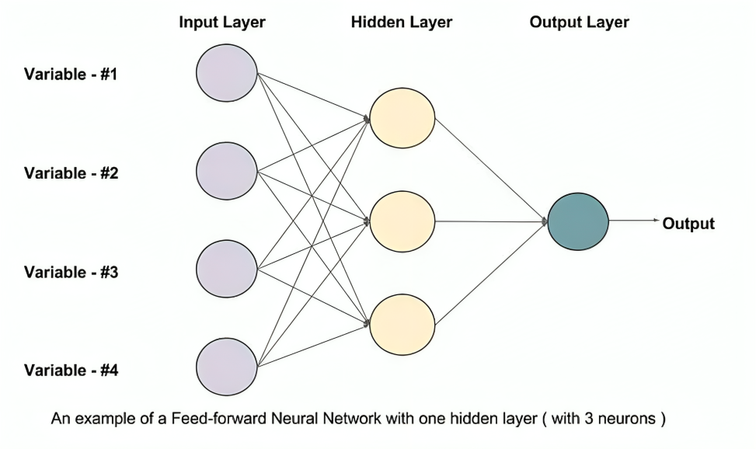
08
Feed-forward IN ANN
Steps involved in how a feed-forward neural network works:
The input data is fed into the input layer.
The weighted sum of the inputs is calculated for each neuron in the hidden layer.
An activation function is applied to the weighted sum of the inputs in each neuron in the hidden layer.
The weighted sum of the outputs from the hidden layer is calculated for the output neuron.
An activation function is applied to the weighted sum of the inputs from the hidden layer to determine the output of the network.

Slide 9
EXPLAINATION OF FEED-forward
09
A feed-forward neural network is a type of artificial neural network that is inspired by the structure of the human brain. It is a computational model that can learn to perform tasks by considering examples, generally through a process of adjusting internal parameters called weights.
The weights of the connections between the neurons are what allow the network to learn. By adjusting the weights, the network can improve its ability to perform a task. This process of adjusting the weights is called training.
Feed-forward neural networks with one hidden layer can be powerful tools for machine learning, but they can also be limited in their ability to learn complex patterns. Networks with more hidden layers, called deep neural networks, can be more powerful, but they are also more complex to train.

Slide 10
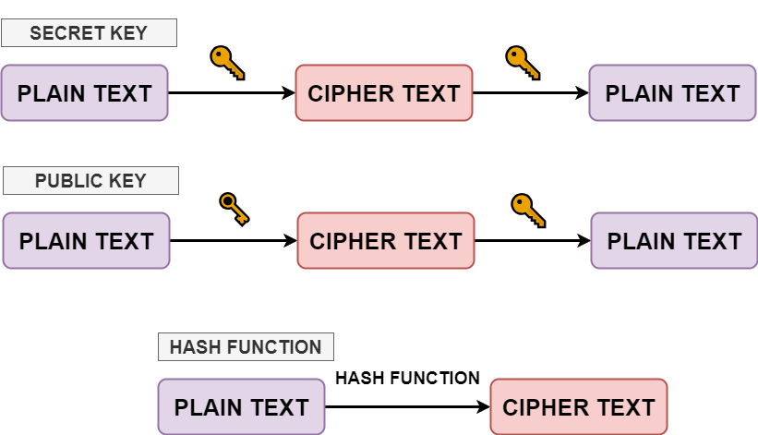
Cryptographic Algorithms-I
10
There are several ways of classifying cryptographic algorithms. Here they will be categorized based on the number of keys that are employed for encryption and decryption. The three types of cryptographic algorithms are:
✅ Secret key (or symmetric) cryptography: Uses the same key for both encryption and decryption. Both parties must share the key securely before communication. It is fast and efficient for large data.

Slide 11
Cryptographic Algorithms-II
11
✅ Public-key (or asymmetric) cryptography: Uses a pair of keys: a public key for encryption and a private key for decryption. The public key can be shared openly, while the private key is kept secret. It enables secure communication without pre-shared keys and supports digital signatures.
✅ Hash functions: Transforms input data into a fixed-size string of characters, typically a hash value. It is a one-way function, meaning the original data cannot be retrieved from the hash. Used for data integrity verification and password storage.

Slide 12
12
Cryptographic using ann-I
In the project cryptography has been achieved by using neural network in the following manner:-
Using a neural network based n-state sequential machine: For a sequential Machine, the output depends on the input as well as the state of the machine. Thus a sequential machine can be used in cryptography where the input data stream is the input to the sequential machine and the state determines the output input relationship. We can use the state of the sequential machine as the key and then use the data as an input to the sequential machine. The relationship between different output and states can be any random but unique sequence providing security to the encryption. As a sequential machine can be implemented by using a neural network, therefore a neural network can be used to encrypt data and another to decrypt data

Slide 13
13
Cryptographic using ann-II
Using a chaotic neural network:
A new chaotic neural network for digital signal encryption and decryption was studied in this project. According to a binary sequence generated from a chaotic system, the weights of neurons are set. The chaotic neural network can be used to encrypt digital signal. The network's features are as follows:
1) High security
2) No distortion
3) Suitable for system integration

Slide 14

14
Conclusion
Artificial Neural Networks (ANNs) are powerful techniques capable of emulating complex computational machines. In this project, we used ANNs to build combinational and sequential logic machines using the back-propagation algorithm. A comparative study of different neural network architectures was conducted, highlighting their respective merits and demerits.
We explored the application of ANNs in cryptography through two methods: a sequential machine-based encryption technique and a chaotic neural network for digital signal cryptography. The results indicate that ANNs have significant potential in data encryption and decryption. Future improvements in code and training algorithms could enhance these results, positioning ANNs as a promising new method for cryptographic applications.
Under the guidance of Prof. seema v. ma’am

Slide 15
THANK YOU !!!
Thank you for engaging with our presentation on our final year project related to Neural Network-Based Cryptography. If you have any questions or are interested in getting involved, please don't hesitate to contact us. Together, let's build the future of digital interaction.
Presentation by:
Armaan Naik | 202101635 | T.Y D
Aliakbar Junnarwala | 202101727 | T.Y D
| T.Y D
| T.Y D
Under the guidance of Prof. seema v. ma’am

